Slide 1
Quản lý nhà trọ
Lớp : PF1117
Nhóm : The Scammer
Thành viên: Lê Duy
Đoàn Quang Huy

Slide 2
Introduction to Project
Currently, with the large population growth, mankind is facing a shortage of housing, many people do not know where to rent or buy a house. Especially in Vietnam, students do not know where to live to be closest to the school.
Due to the increasing demand of houses in the Vietnamese, this program was created to help students find their home.

Slide 3
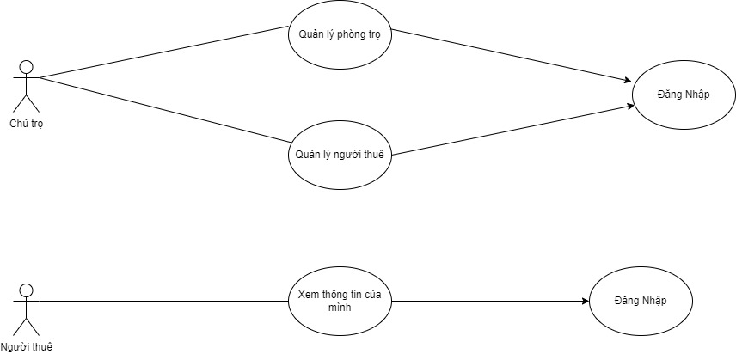
Use Case

Slide 4
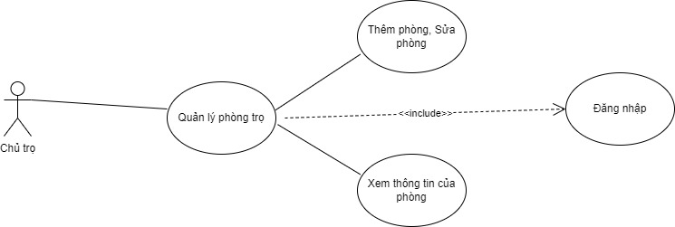

Slide 5
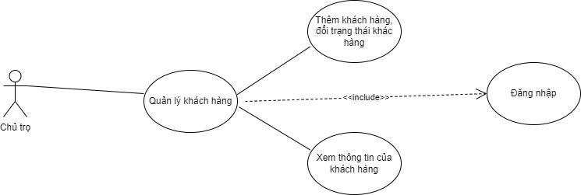

Slide 6
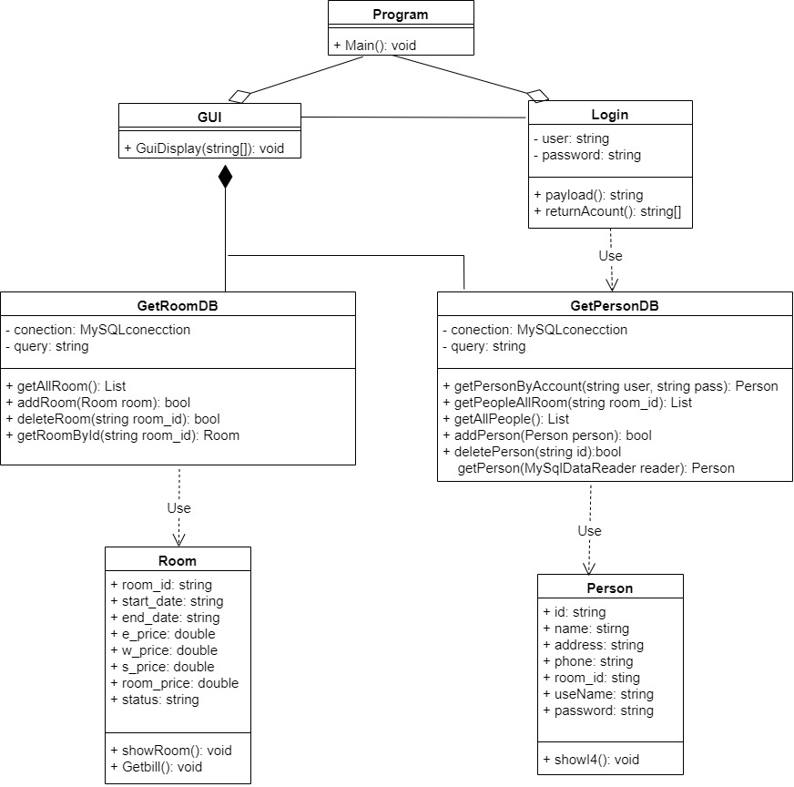

Slide 7
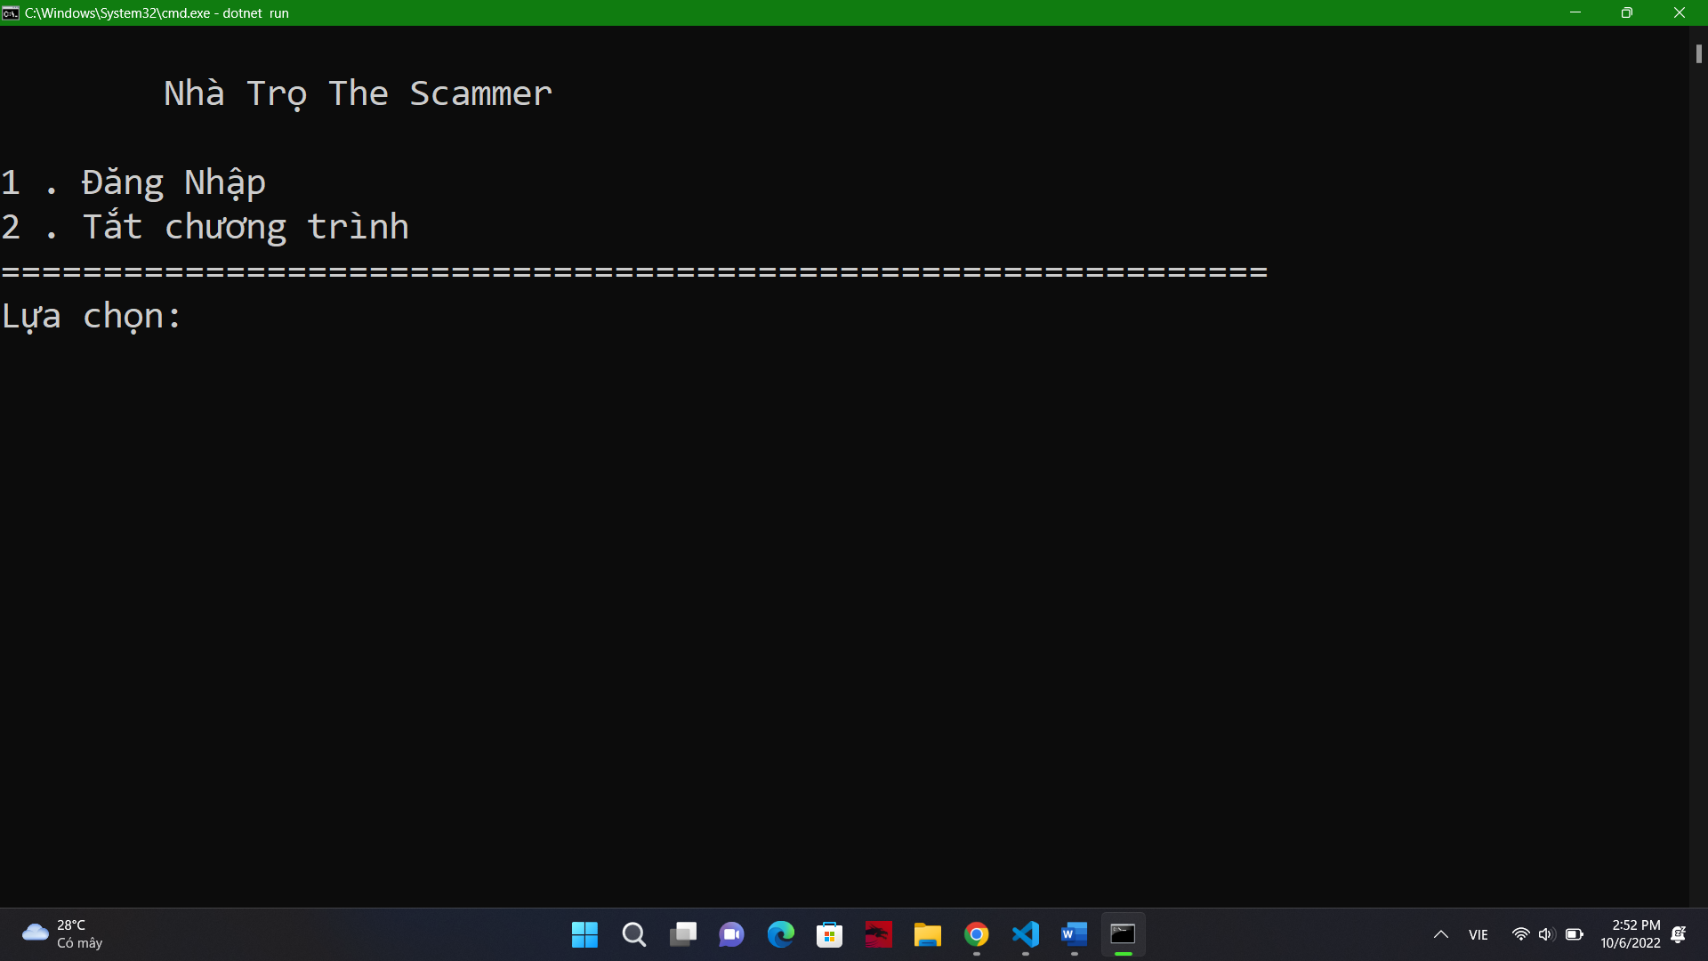

Slide 8
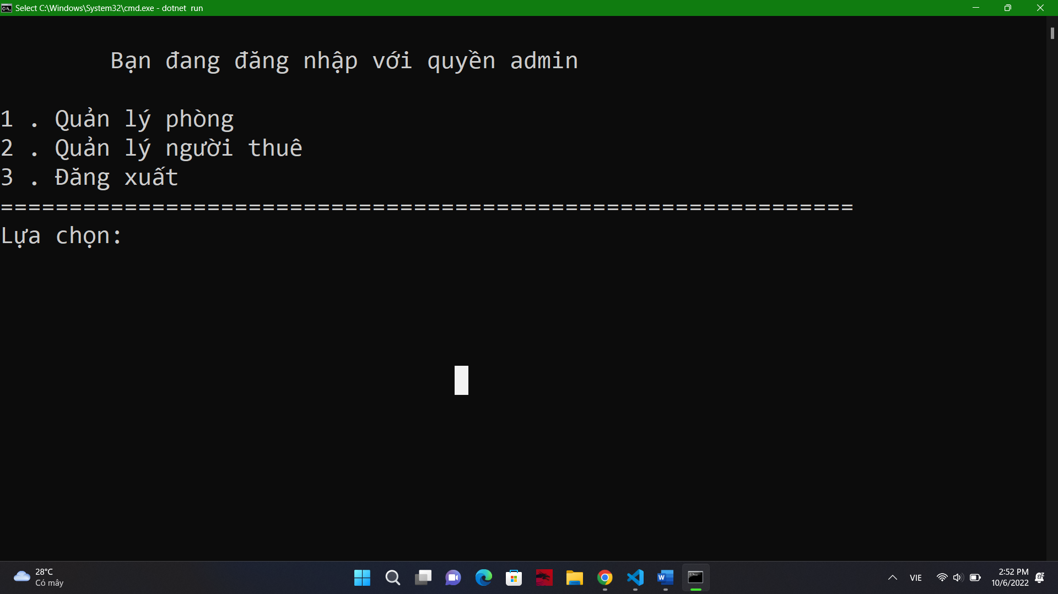

Slide 9
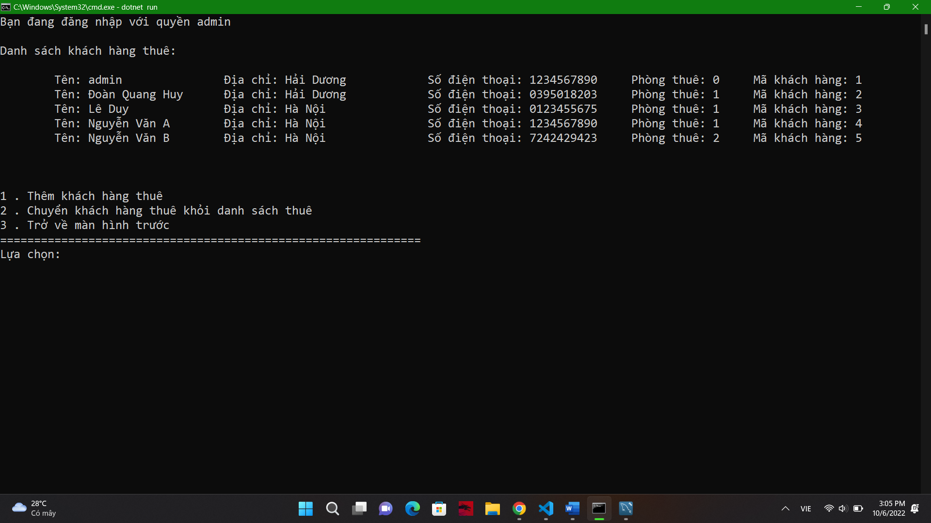

Slide 10
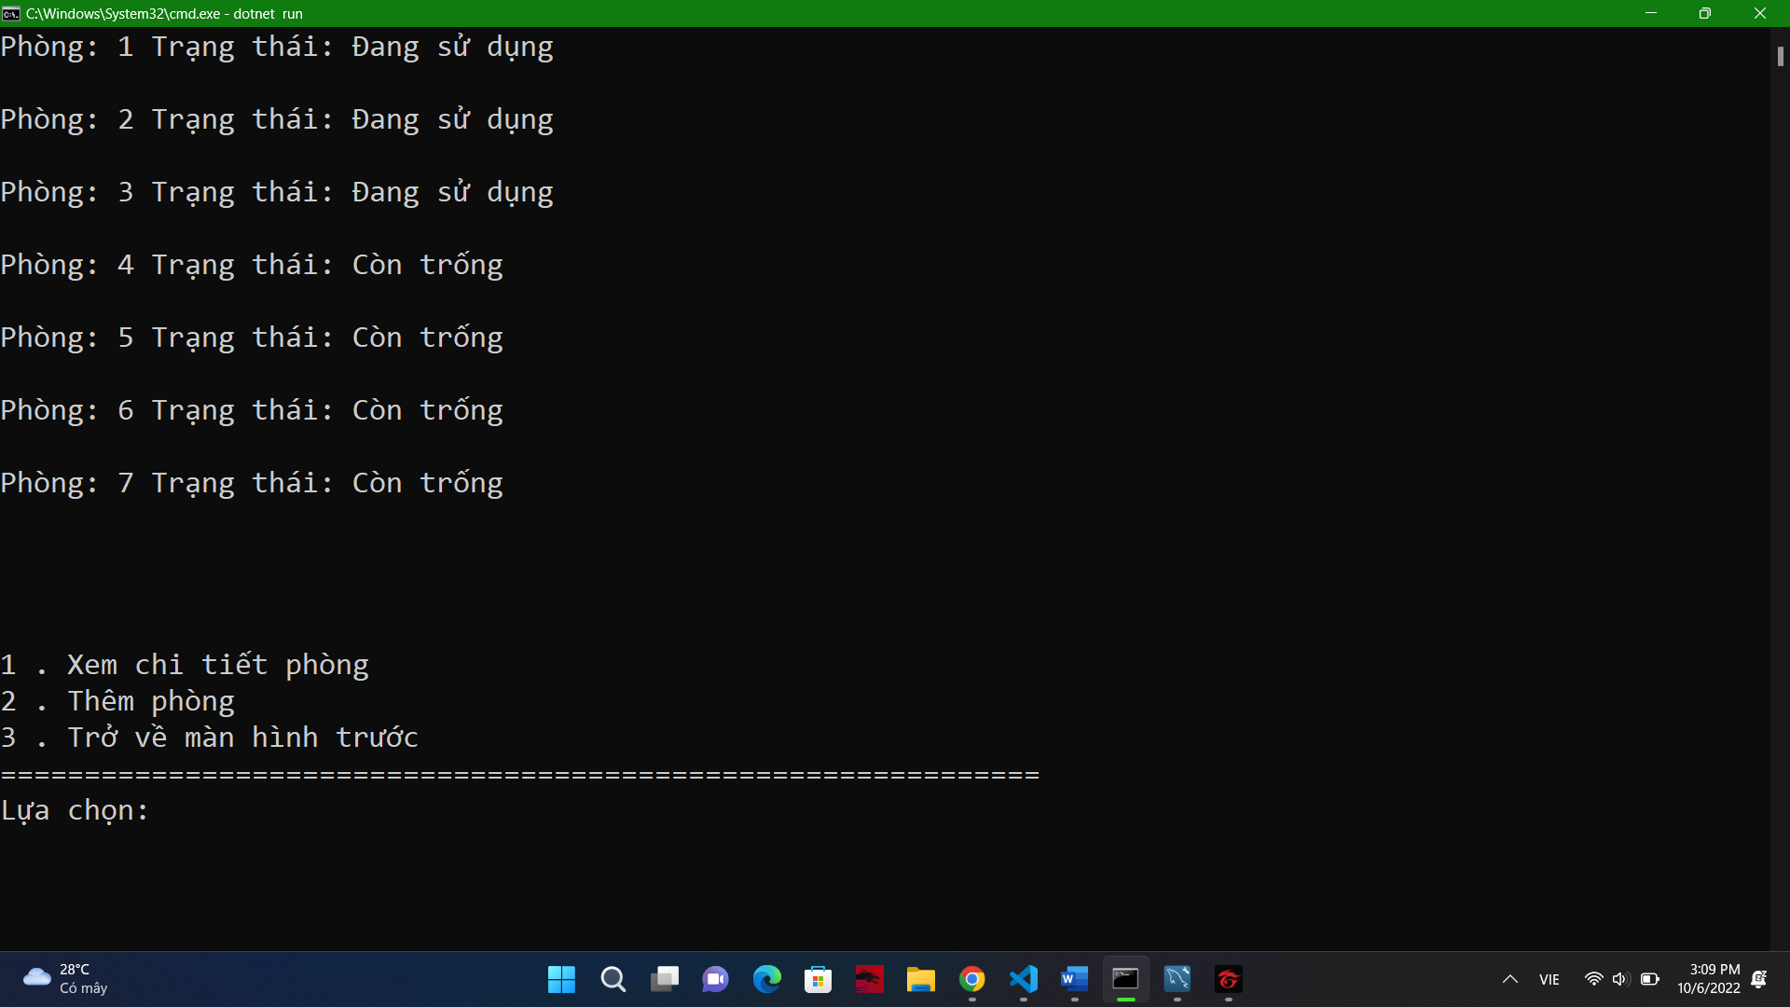

Slide 11
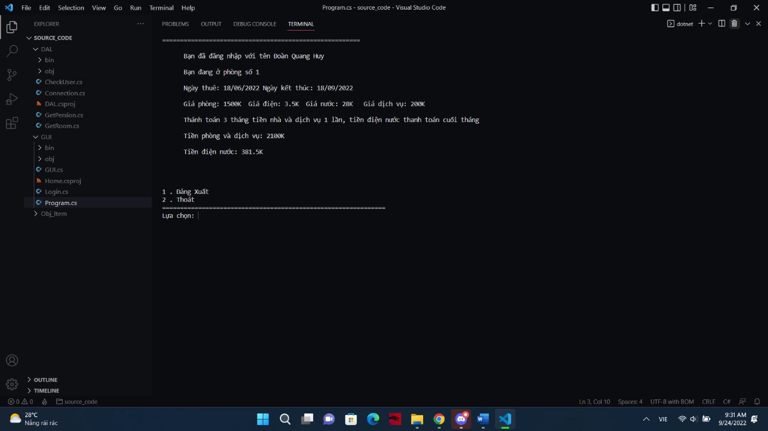

Slide 12


